Slide 1


CHARM TECHNICAL MEETING 29-03-2022
Jérôme LENDARO on behalf of CHARM team

Slide 2
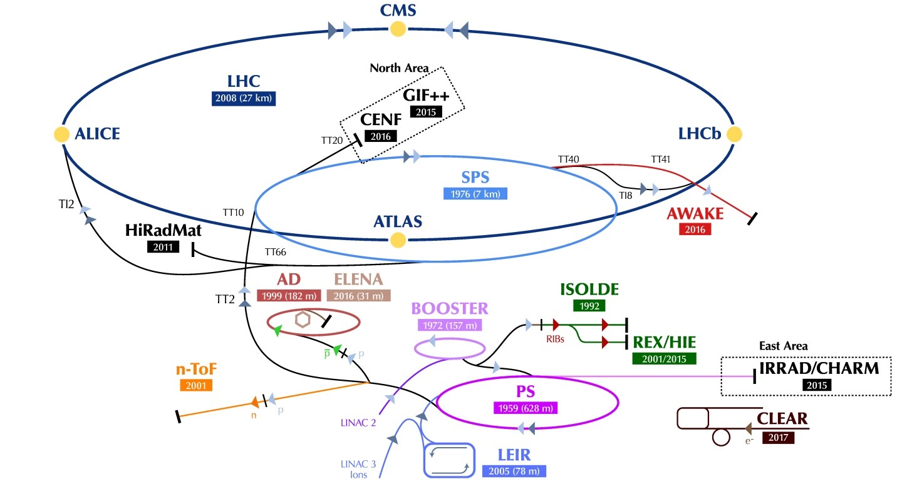
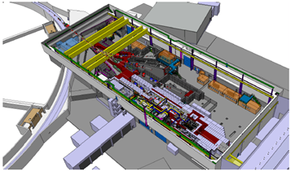
Location
Jérôme LENDARO on behalf of CHARM team, CHARM TECHNICAL MEETING, 29-03-2022

Slide 3
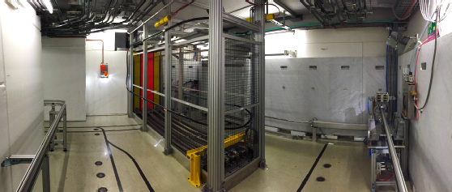
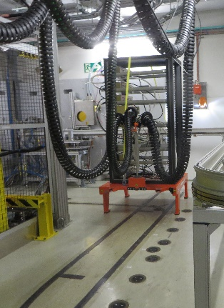
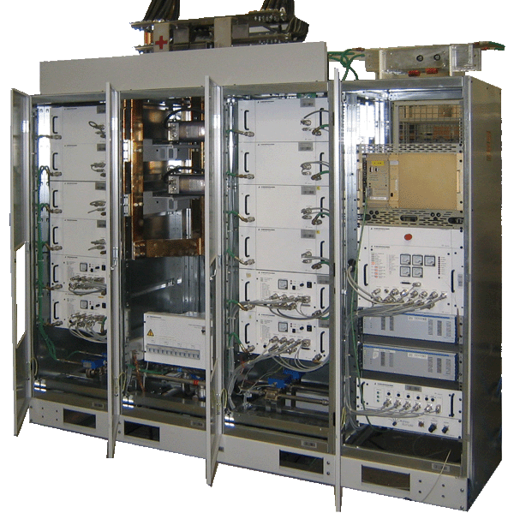
CHARM
Cern High Energy AcceleRator Mixed-Field
Read the operational procedure : EDMS 1553262
Jérôme LENDARO on behalf of CHARM team, CHARM TECHNICAL MEETING, 29-03-2022

Slide 4
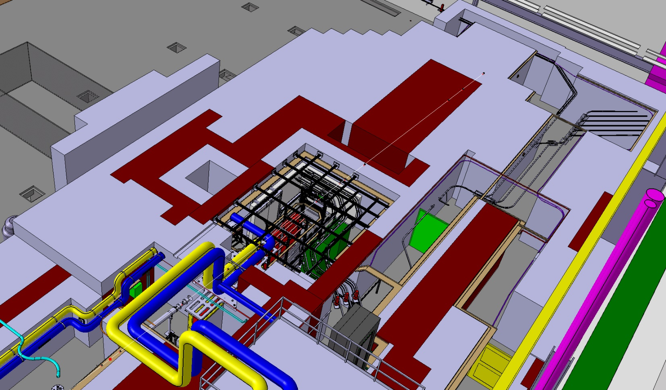
Layout
Target and Test Zone
Storage Area
(Buffer Zone)
Patch Panel area
Access Corridor

Slide 5
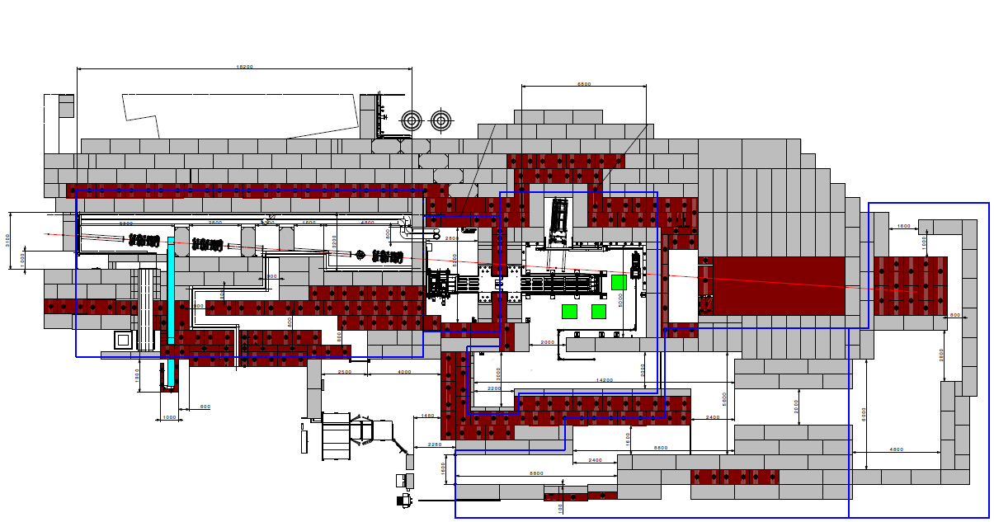
East Area Irradiation Facility
Primary beam line from PS (T08): 24 GeV/c proton beam
CHARM irradiation area is placed downstream to IRRAD on the T8 line
PS p+
24 GeV/c
~400ms spill
DUMP
IRRAD
ENTRANCE
CHARM
Jérôme LENDARO on behalf of CHARM team, CHARM TECHNICAL MEETING, 29-03-2022

Slide 6
COVID-19
Restrictions of EAST AREA User Control Roooms with Respect to the COVID-19 Risk https://edms.cern.ch/document/2615669/1
Preparation room 1-N26 : 5 people maximum
Control room : 1-N28 : 2 people maximum
Everyone, even if alone inside a room, shall wear a mask Type 1 at all time.
Everyone shall wash/disinfect their hands as often as reasonably possible, at least before and after using shared tools (i.e. keyboard, mouse, etc.).
If it is not possible to have personal tools, the users should disinfect shared material before and after use.
The 1,5 meters distance shall be kept at all time by all people present in the control room; the usable desks (1,5m distance) shall be clearly marked.
These restrictions are currently evaluated by HSE department following the passage to level 1 on 14/03/2022
Jérôme LENDARO on behalf of CHARM team, CHARM TECHNICAL MEETING, 29-03-2022

Slide 7
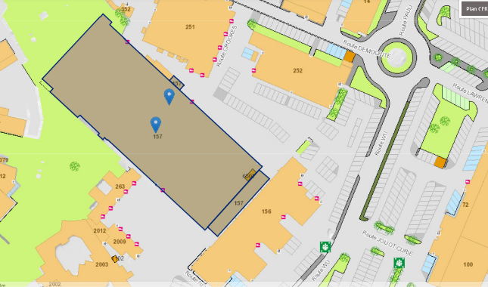
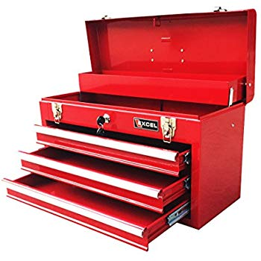
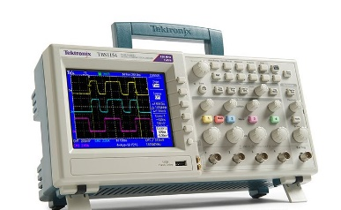

Dry run : Preparation room 157/1-N26
Wednesday
Thursday
Friday
Monday
Tuesday
Wednesday
Thursday
Friday
Dry run period
Irradiation test
Room 157-1-N26
Bring your own tools and instruments
Please inform CHARM team in case of problem or delay expected
Jérôme LENDARO on behalf of CHARM team, CHARM TECHNICAL MEETING, 29-03-2022

Slide 8
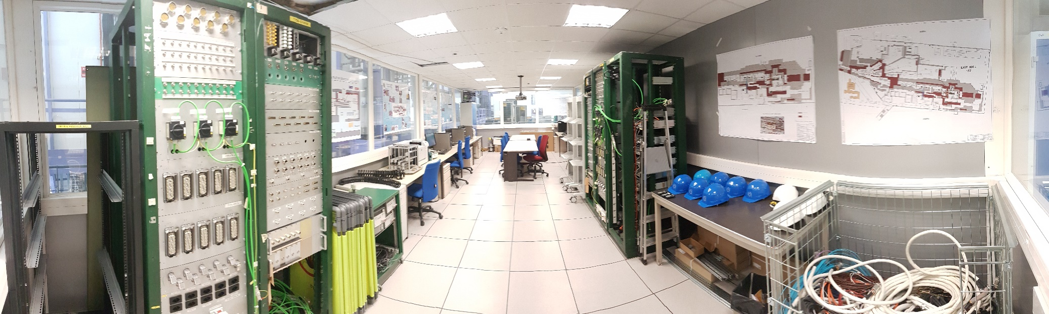

Dry run : Preparation room 157/1-N26
Jérôme LENDARO on behalf of CHARM team, CHARM TECHNICAL MEETING, 29-03-2022

Slide 9
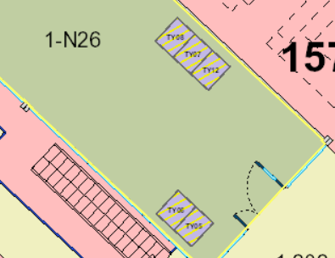
Dry run : Preparation room 157/1-N26
TY07-TY08
Data acquisition patch panels
TY05-TY06
Irradiated material patch panels
Jérôme LENDARO on behalf of CHARM team, CHARM TECHNICAL MEETING, 29-03-2022

Slide 10
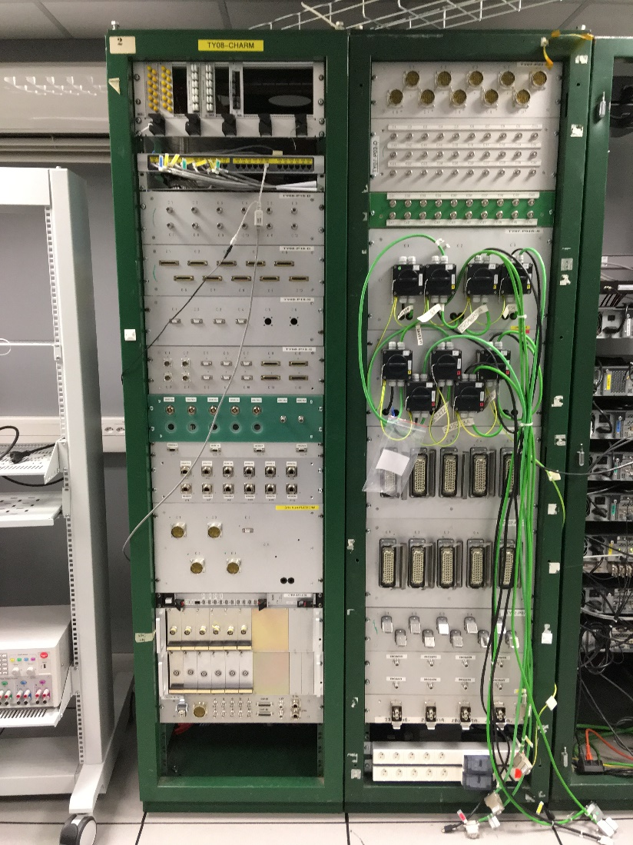
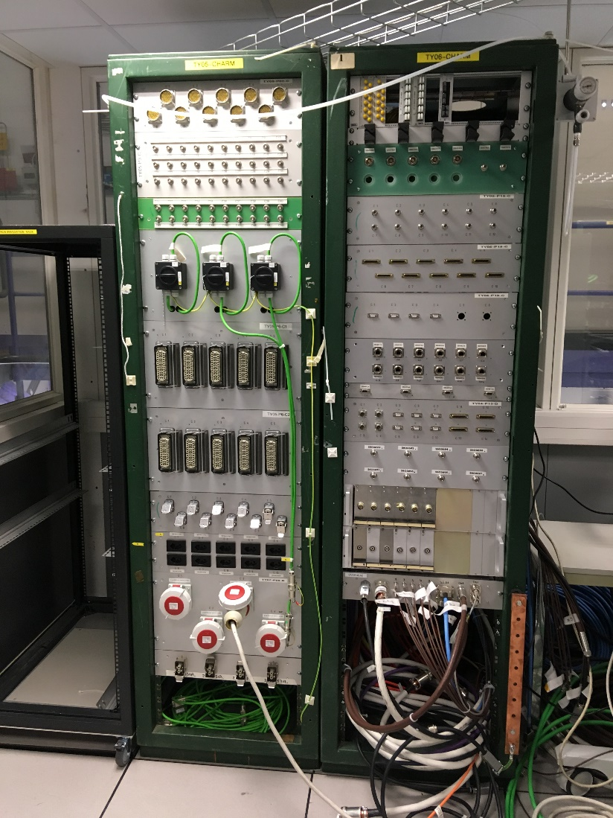
Dry run : Preparation room 157/1-N26
Data acquisition patch panel
Irradiation panel
Jérôme LENDARO on behalf of CHARM team, CHARM TECHNICAL MEETING, 29-03-2022

Slide 11
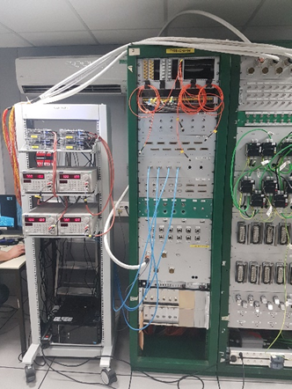
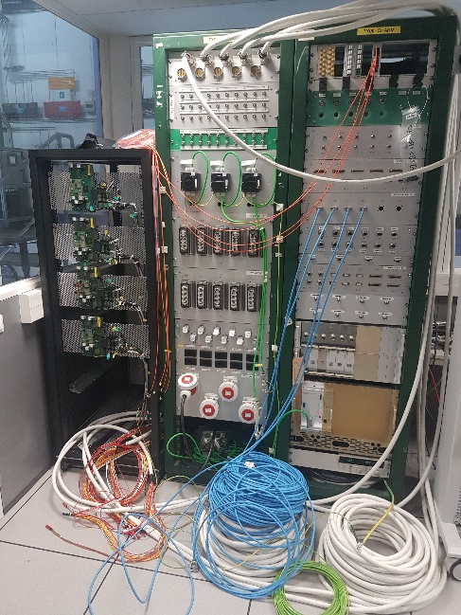
Dry run : Preparation room 157/1-N26
Data acquisition electronic installed inside “LabRack” provided by CHARM. Users can also bring their own rack pre-equipped (edh handling request to be done to move the rack at 1st floor)
Irradiated material installed in the test rack, the overhead conveyor or Montrac mock-up
Data acquisition system
Material to be irradiated

Slide 12
Dry run : Preparation room 157/1-N26
Starting from Wednesday afternoon the week before the beam test
Use UPS protected 230V sockets (orange label)
Please keep the room tidy
No tools or instruments available
Cables must be properly labelled and as easy and fast as possible to connect /disconnect (no terminal screw)
No dangerous active parts (<50V) accessible (IP2x)
Water leak detection to be implemented in case use of water cooling
Please inform CHARM team in case of problem or delay expected
Cables used to connect the patch panels should be the cables that will be used for the irradiation test (already installed or not in the cable holder)
Jérôme LENDARO on behalf of CHARM team, CHARM TECHNICAL MEETING, 29-03-2022

Slide 13
Cables lengths
Permanent cables between patch panels : 17m
Data acquisition system : 3m
G0 (wall) : 8m
G16 (overhead conveyor) : permanent cables installed, 45m
Montrac : case by case
Mobile rack :
https://charm.web.cern.ch/content/cables-and-networking
Test position | Cable holder lenght | Cable total lenght
1 to 3 | 10.8m | 15m
4 to 10 | 15.6m | 19m
11 to 13 | 20.4m | 24m
Jérôme LENDARO on behalf of CHARM team, CHARM TECHNICAL MEETING, 29-03-2022

Slide 14
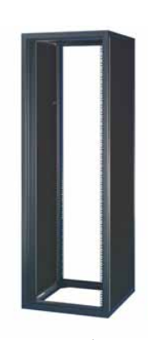
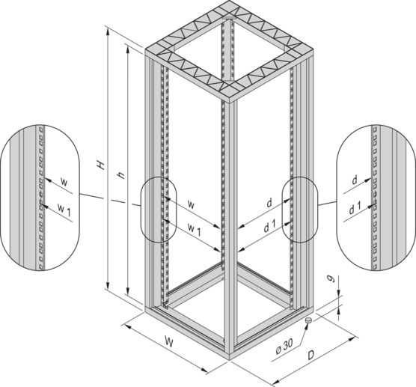
AGV conveyor (Positions 1 to 13)
19’’ frame
Height 1620mm (34U)
Width: 600 mm
Depth: 900 mm
Schroff nvent Ref 22117-774

Slide 15
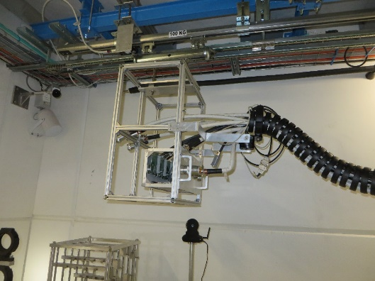
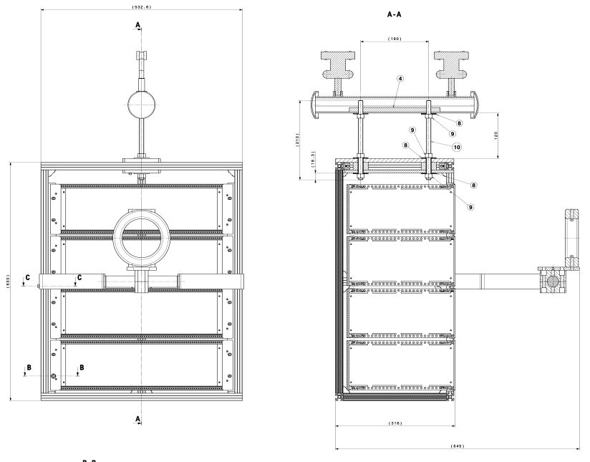
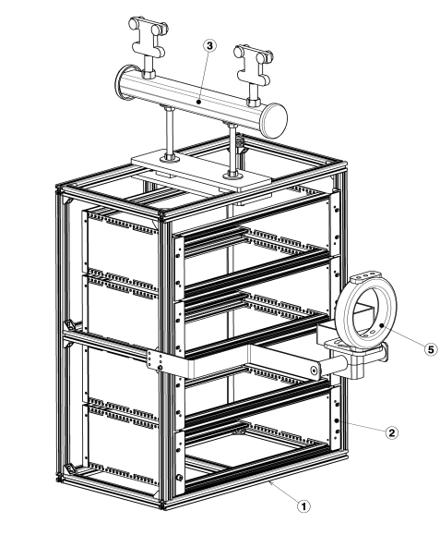
Overhead conveyor (Position G16)
19’’ frame
Height 12U
Chassis max depth : 316mm
Mockup available in preparation room
PSZJS___0122 : EDMS 1607533
Jérôme LENDARO on behalf of CHARM team, CHARM TECHNICAL MEETING, 29-03-2022

Slide 16
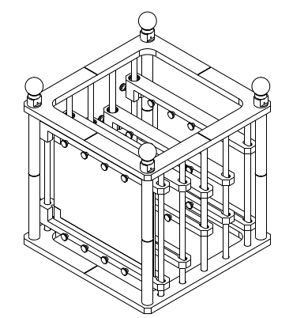
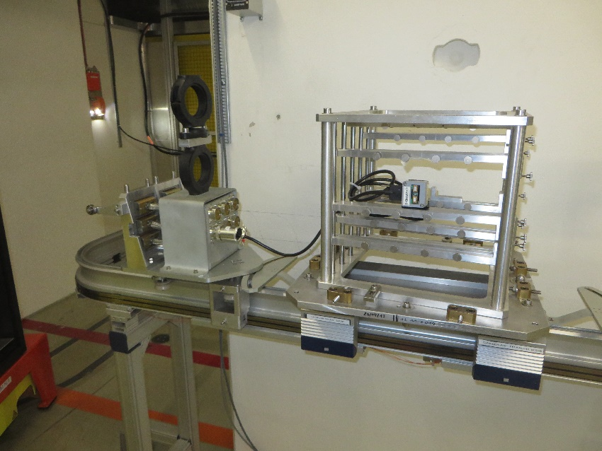
MONTRAC conveyor (Position G16)
Mockup available in preparation room
PCB max dimensions : 250mmx 300mm
6x NE48 female socket available
PS_TMCS_0085 : EDMS 1373149
Jérôme LENDARO on behalf of CHARM team, CHARM TECHNICAL MEETING, 29-03-2022

Slide 17
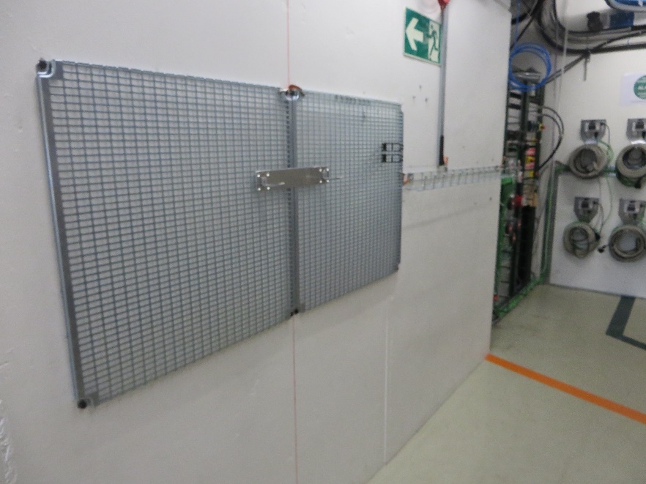
Wall grid (Position G0)
Jérôme LENDARO on behalf of CHARM team, CHARM TECHNICAL MEETING, 29-03-2022

Slide 18
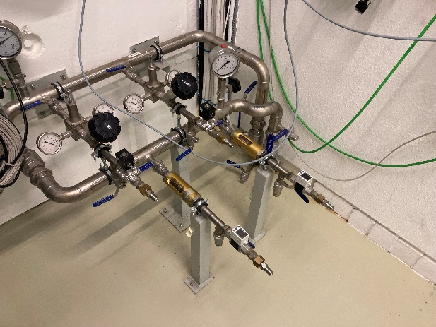
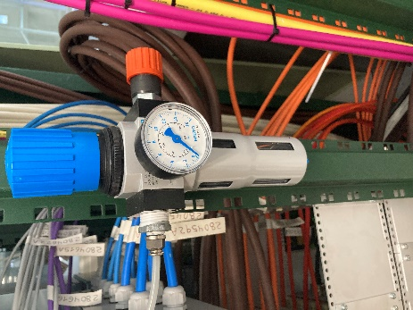
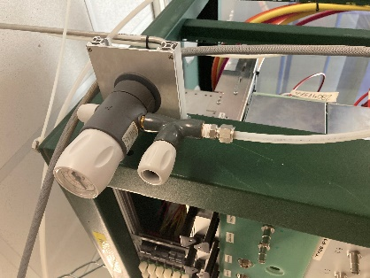
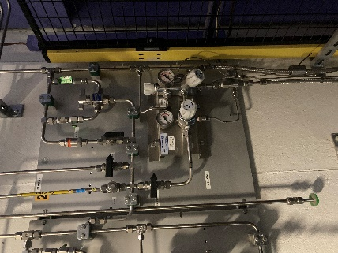
Services available
Compressed air (up to 9 bars, Oeticker quick connector)
Gaz (non flammable). Bottle to be provided by users
IT network (GPN and TN) available in preparation and control rooms
Demineralised water circuits
Water distribution
Compressed air
Gas distribution
Jérôme LENDARO on behalf of CHARM team, CHARM TECHNICAL MEETING, 29-03-2022

Slide 19
Services available
Compressed air (up to 9 bars)
Oeticker connector SCEM 41.60.10.B
Gaz (non flammable). Bottle to be provided by users
RILSAN, POLYAMID (SCEM 38.40.30.608.0) 6-8mm . Other diameter can be available on request
Demineralised water circuits
EPDM Tube : SCEM 38.20.10
Parker female connector (SCEM 41.62.00.110.5) ref SSH2-62W BSPP
Jérôme LENDARO on behalf of CHARM team, CHARM TECHNICAL MEETING, 29-03-2022

Slide 20
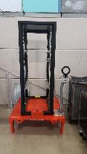
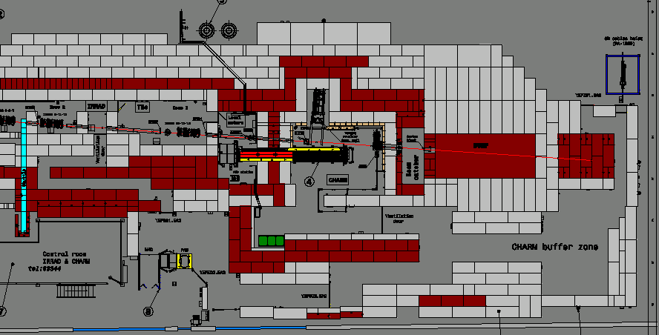
Preparation for beam test
By Tuesday 14H: The devices to be irradiated should be installed in the final rack located in the assembly area 157-R-O19
By Tuesday 16H: Installation of the cables into the flexible chain. Bld 157, north side
Note : the users that test in G0 or G16 as well as the users installing their setup into the rack already inside the beam area are not concerned by the steps above
Please inform CHARM team in case of problem or delay expected
Rack in the assembly area
Cables holder preparation area

Slide 21
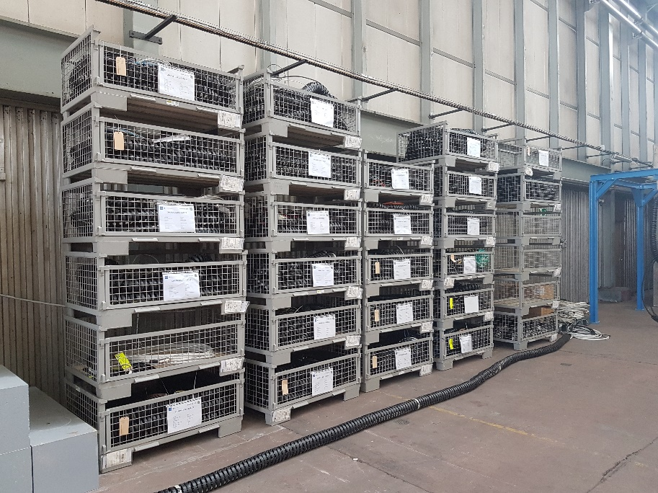
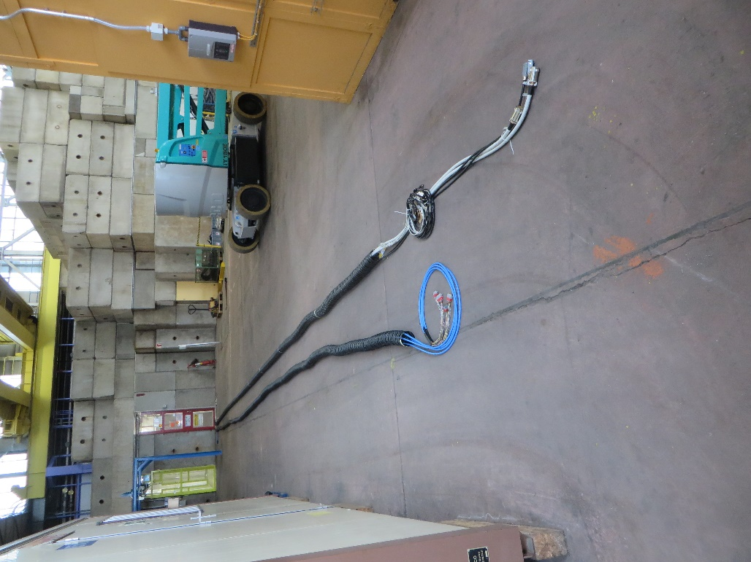
Preparation for beam test
Patch panel
Cables chains storage area
Irradiated device
Cables chains preparation area
Jérôme LENDARO on behalf of CHARM team, CHARM TECHNICAL MEETING, 29-03-2022

Slide 22
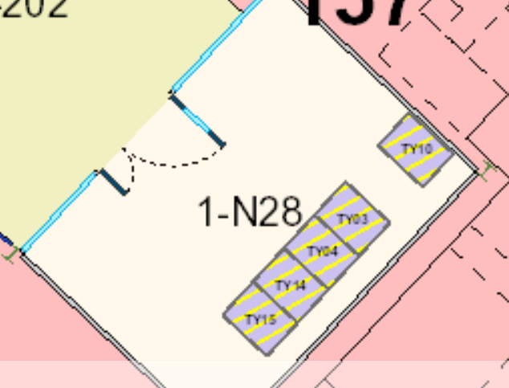
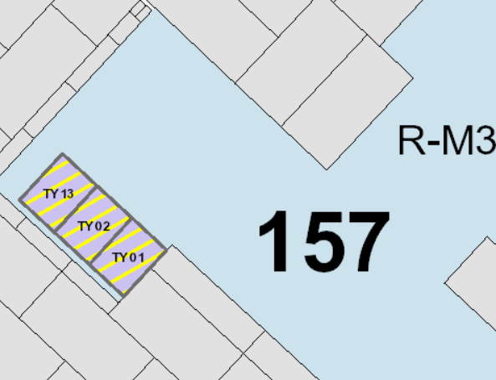
Beam test: Control room 157/1-N28
TY03-TY04-TY14
Data acquisition patch panels
TY01-TY02-TY13
Irradiated material patch panels
Jérôme LENDARO on behalf of CHARM team, CHARM TECHNICAL MEETING, 29-03-2022

Slide 23
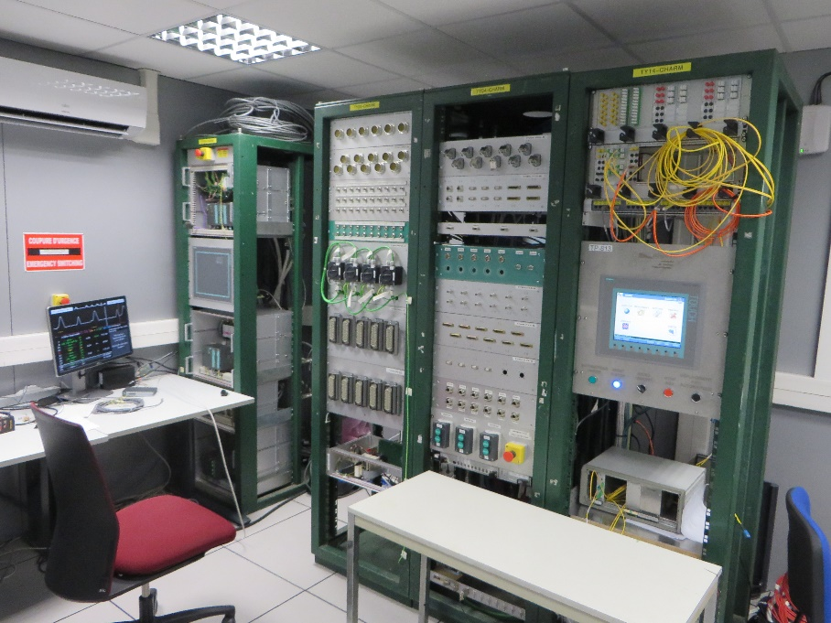
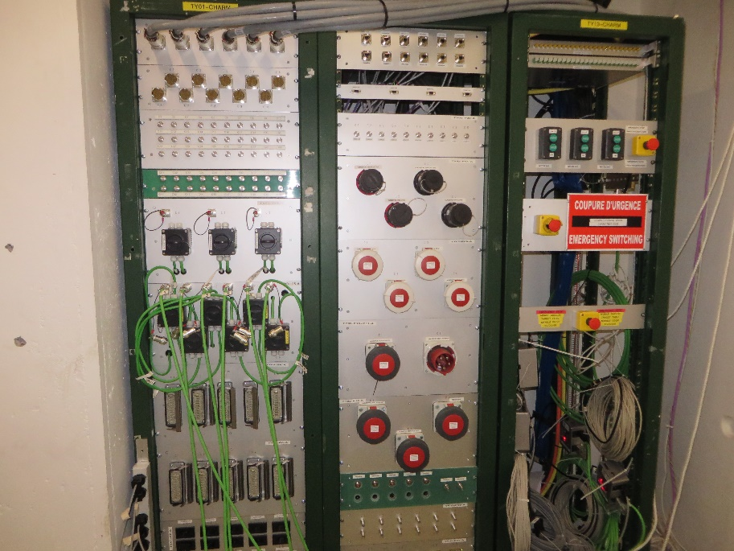
Beam test
Data acquisition panel
Irradiation panel
Jérôme LENDARO on behalf of CHARM team, CHARM TECHNICAL MEETING, 29-03-2022

Slide 24
Installation in the beam area
Access to beam area on Wednesday morning from 9h
As soon as previous users removed their rack from control room 157-1-N28: installation of the new rack (not powered)
Access in beam area on agreement with CHARM team
Connection of the cables : patch panel + rack (1 team at a time)
Powering and test of the setup (after confirmation of CHARM team)
Transport of the rack to final test position
End of access
Beam expected usually in the afternoon
Jérôme LENDARO on behalf of CHARM team, CHARM TECHNICAL MEETING, 29-03-2022

Slide 25
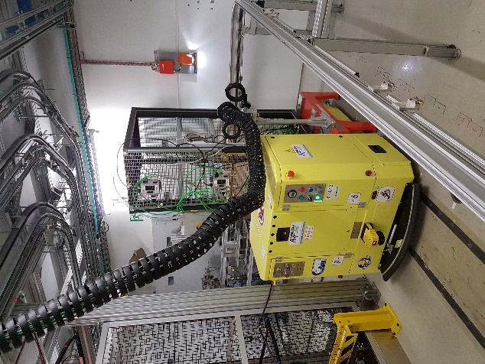
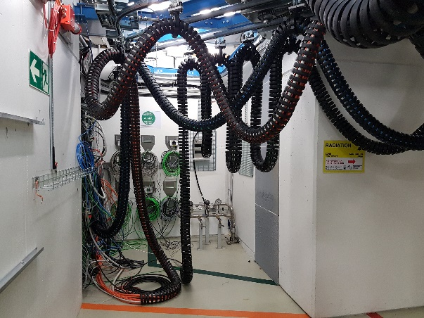
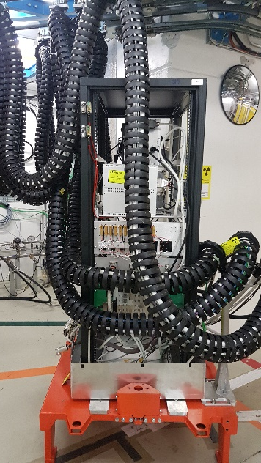
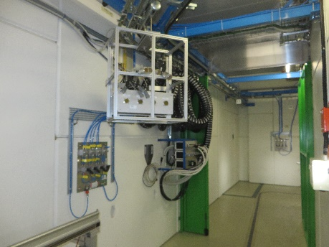
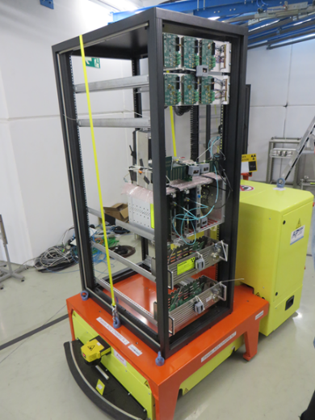
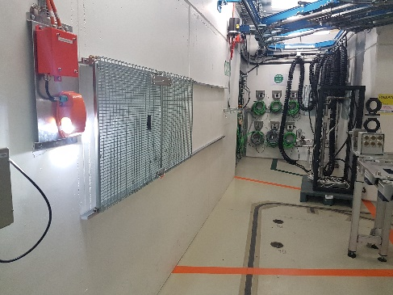
Installation in the beam area
Patch panel
Rack to be irradiated
Installation
Overhead (G16)
G0

Slide 26

During the beam test
No access possible into the beam area for the whole week
No restriction to access in preparation and control rooms
Personal dosimeter mandatory
No drink or food
Close the doors as often as possible (air conditioning)
No access possible into the beam area for the whole week
Jérôme LENDARO on behalf of CHARM team, CHARM TECHNICAL MEETING, 29-03-2022

Slide 27
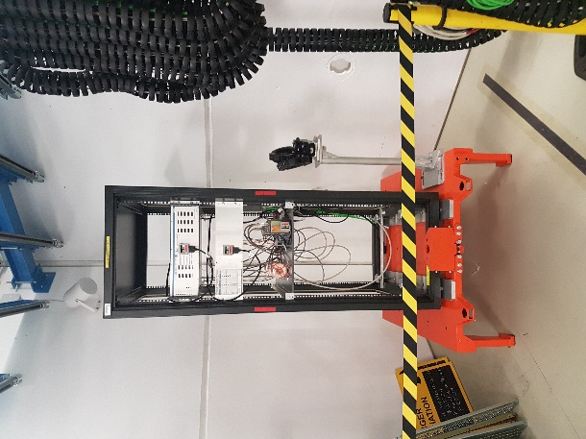
End of the test
Access on Wednesday morning
Disconnection patch panel + rack
Protection of câbles connectors for storage
Material stored 1-2 weeks in internal buffer zone for cooldown
User will be contacted few weeks later to retrieve their materials (TREC registration from RP buffer zone 157/R-O21)
The facility can store the cables for later reuse
Keep the control room tidy and clean
Jérôme LENDARO on behalf of CHARM team, CHARM TECHNICAL MEETING, 29-03-2022

Slide 28
Remarks
Access rights required : IRRADS, 157/1-N26, 157/1-N28, 157/R-O19
Safety trainings : Safety at CERN, Electrical Safety, Beam Facilities, CHARM, Radiation Protection - Supervised Area, Radioactive Equipment - Traceability - TREC
Safety material : Personal dosimeter, shoes, helmet,
Bring your own tools
Preferably take active dosimeters (DMC) from bld 55
IMPACT managed by CHARM coordination (list of names to provide)
Networks requests to be done ASAP (Dry run + control room)
COVID rules : https://edms.cern.ch/document/2615669/1
Jérôme LENDARO on behalf of CHARM team, CHARM TECHNICAL MEETING, 29-03-2022

Slide 29
Useful Links
CHARM website: https://charm.web.cern.ch
Facility monitoring:
ADAMS: http://www.cern.ch/adams/
Monitoring tool : (code to be provided by CHARM team) Charm_MonitoringTool_v2
Training center : https://lms.cern.ch
Network: https://network.cern.ch
Jérôme LENDARO on behalf of CHARM team, CHARM TECHNICAL MEETING, 29-03-2022

Slide 30
Jérôme LENDARO on behalf of CHARM team, CHARM TECHNICAL MEETING, 29-03-2022

Slide 31


